Slide 1
IE260 Lecture 5: Dynamic Programming
Il-Chul Moon
Department of Industrial and Systems Engineering
KAIST
icmoon@kaist.ac.kr

Slide 2
Short Recap

Slide 3
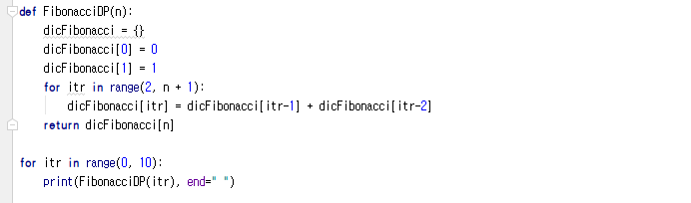
Implementation Example: Fibonacci Sequence in DP
Setting up a memoization table
Building up a bigger solutions
Execution Part
Use a dictionary collection variable type for memoization
Memoization
Storing a fibonacci number for a particular index
Now,
We have a new space requirement, the dictionary or the table, of O(N)
We have reduced execution time from O(2^{n}) to O(N)
Notes:
Thus far, we’ve reviewed the concepts related to techniques: dynamic programming and memoization.
Now it’s time to exercise the concepts by applying them to the Fibonacci sequence.
The last time we used the Fibonacci sequence, we solved the problem with a recursion, which called a function within a function.
By employing dynamic programming, however, there is nothing we can use to directly to call a function within the function.
This is a memoization table, a space that may accumulate any solutions from small-scale problems.
In other words, it is a dictionary.
A dictionary assumes a form to store key-value pairs.
It stores 0 in a key named 0 and 1 in a key called 1.
If we were to write down keys and values for the Fibonacci sequence, the default and current condition would stores0 in the key 0 and 1 in the key1.
Let’s consider about a situation with Fibonacci(4).
As n equals 4, given that 0 and 1 are in there by default, the iteration begins with 2.
At the end, it will be 5 as it is “n + 1”, and the iteration may go on until 4, or less than 5.
The list obtained from the range is [2, 3, 4].
The first itr in this situation will be 2.
So, we have 2 entered here.
Given that itr is 2, as the values of itr-2 = 0 and itr-1 = 1 are added, it will place value 1.
Here, you will find a “for” loop running around one sentence.
It will make itr to be 3 for the next iteration.
Thus, it will be 3 as well as itr-2 = 1 and itr-1 = 2.
It indicates that the values 2 and 1 should be combined so that it will be 2 with the key 3.
Finally, itr becomes 4.
It results in itr-2 = 2 and itr-1 = 3
Consequently, the key named 4 will get the value 3.
Finally, it will return dicFibonacci[n].
As n = 4, dicFibonacci will return 3, the value for the key 4.
Unlike the previous case, dynamic programming allows us to complete the process with a single “for” loop.
Instead, it will pile up from smaller values in the memoization table.
Applying the dictionary collection, we were able to create the memoization table for dynamic programming with no trouble.
We will cover the dictionary collection about 3 weeks later.
This is a Big-o-notation, a value to represent certain limitation.
The table will have a total of N rows.
So, it is O(N).
In a recursion, it kept on dividing into branches as in the tree structure here.
In this way, we already have 2³-1 with just three layers.
It’s uncountable.
Although this recursion requires innumerous function calls, we can conduct the same operation with just N memoizations.

Slide 4
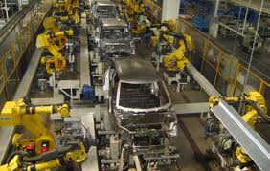
Assembly Line Scheduling
Assembly Line 1
station S_{1,1}
station S_{1,2}
station S_{1,3}
station S_{1,4}
station S_{1,5}
station S_{1,6}
7
9
3
4
8
4
2
1
3
4
3
2
3
Production Start
Production End
2
1
2
2
1
4
2
8
5
6
4
5
7
station S_{2,1}
station S_{2,2}
station S_{2,3}
station S_{2,4}
station S_{2,5}
station S_{2,6}
Assembly Line 2
Goal: Computing the fastest production route
Notes:
Now let’s consider the way to apply it not to the Fibonacci sequence, but something more realistic.
Dynamic programming is indeed very useful in reality.
One of the most important examples is a production process.
This is an automobile left unfinished.
This vehicle gets assembled piece by piece throughout the production process.
If we assume that the automobile should go through six robots in the production line, two lines could be in operation.
It would be ideal to carry out the production process according to a schedule, but isn’t always attainable.
This is because various unexpected events might occur. For example, there may be a lack of parts or a malfunction with the robotic machinery.
So, if we thinking of one whole process as a station, each station may have different duration.
Then, the difference in time for the stations allows us to figure out how to minimize the total duration by sending newly introduced products into available lines.
This is the part at which the production starts, and that is where production ends.
The number here represents the time consumed.
It signifies the duration of time for transferring goods from one process to another or for the completion of a process.
Here, it says it takes 4, 8, 5, 6, 4, 5, 7, and finally 2 seconds.
This line requires 2, 7, 9, 3, 4, 8, 4, and 3 seconds.
With the lines set parallel to each other, each line has six stations.
If this station takes a longer time because it is bottlenecked, it is possible to route some of the work out to this part.
That’s why one way is to continue the next process: moving the work into the line next to the original one.
This shows the arrow from the side, and the number is the time consumed to transfer.
Suppose that it won’t take long to move from one line to the other.
From the beginning of the assembly, we can apply dynamic programing to minimize inefficiency. We can reduce the time required for the most basic goods to be moved to a station and for continuing the assembly work by transferring work to the next line, as well as the time to produce the goods after the final process.
Dynamic programming can offer a solution for this kind of production line plan or schedule.
Let’s find out how to apply dynamic programming to this type of problem.

Slide 5
Process of Assembly Line Scheduling
Assembly Line 1
station S_{1,1}
station S_{1,2}
station S_{1,3}
station S_{1,4}
station S_{1,5}
station S_{1,6}
7
9
3
4
8
4
2
1
3
4
3
2
3
Production Start
Production End
2
1
2
2
1
4
2
8
5
6
4
5
7
station S_{2,1}
station S_{2,2}
station S_{2,3}
station S_{2,4}
station S_{2,5}
station S_{2,6}
Assembly Line 2
Time | 1 | 2 | 3 | 4 | 5 | 6
L1 | 9
L2 | 12
Trace | 1 | 2 | 3 | 4 | 5 | 6
L1 | S
L2 | S
Notes:
We’ve learned that the basic mechanism of dynamic program is a bottom-up approach.
Simply put, it breaks down a larger problem into smaller chunks.
Thus, we’ve got to start from the easiest problems rather than attempting to chart the entire route right away.
Let’s take a stab at when the first station would be completed, whichever line the goods take.
Our goal is to solve the final problem by building up from the smaller problems, step by step.
Let’s examine how to store the processes of solving small problems at a higher level.
In this regard, we will plan out the structure of the memoization table like this.
First, we would call it “travel time.”
I’ll write down the shortest time to arrive at the station of each line as the travel time.
No matter what method we adopt, the 1st station of the 1st line takes at least 9 seconds.
The minimum time required for the 1st station of the 2nd line is 12 seconds.
Thus, this is the minimum travel time, which could serve as a basic unit to be accumulated and to eventually determine which line would offer the shortest process times.
After that, we do not just write down the minimum travel time. We also write what is called a retrace table that shows which path has been taken to get here.
Later, I will show you how to recognize which path has been taken to get here with this retrace table.
It’s no problem up until the 1st station.
In this scenario, there is no backward direction. We can only move in a single direction.
It took 2 and 7 seconds for the 1st line, totaling 9 seconds, while the 2nd line took 4 and 8 seconds, totaling 12 seconds.
Similarly, as we only have one departure spot or “start point,” we can save the prior locations of the two lines before arriving at here as the “start point.”
It makes it clear that that it unconditionally takes at least 9 seconds or 12 seconds from here to there.
Now that we’ve figured out this much in this small problem, we can work on this problem at a larger scale.

Slide 6
Process of Assembly Line Scheduling
Assembly Line 1
station S_{1,1}
station S_{1,2}
station S_{1,3}
station S_{1,4}
station S_{1,5}
station S_{1,6}
7
9
3
4
8
4
2
1
3
4
3
2
3
Production Start
Production End
2
1
2
2
1
4
2
8
5
6
4
5
7
station S_{2,1}
station S_{2,2}
station S_{2,3}
station S_{2,4}
station S_{2,5}
station S_{2,6}
Assembly Line 2
Time | 1 | 2 | 3 | 4 | 5 | 6
L1 | 9 | 18
L2 | 12 | 16
Trace | 1 | 2 | 3 | 4 | 5 | 6
L1 | S | 1
L2 | S | 1
Notes:
Up to this point, it takes 9 seconds with no exceptions.
That’s the minimum time.
In this scenario, let’s find out how long it takes to get to the 2nd station.
Now the problem gets more challenging.
There are a total of two ways to get to the station2 of the 1st line.
One is to pass through the line, staying in the line where it was originally located, and the other is to use the line next to the original.
If we choose the 1st method, it took a minimum of 9 seconds to arrive at the 1st station and another 9 seconds were required to handle here. This is a total of 18 seconds.
As for the 2nd method, it took 12 seconds to reach the 1st station in the 2nd line, and 2 seconds to move to another station, and 9 seconds in this station, totaling 23 seconds.
So, the fastest way to get to this location is to select the 1st method.
It takes 18 seconds.
Otherwise, we may choose to trace up from the bottom. However, this won’t be a good alternative since it would take 23 seconds.
Next, let’s consider the 2nd station of the line down below.
In this case, there are two ways available: one is to proceed with the 2nd line as it is, and then select the 1st line.
If we think about the way to get down from the top, we should add 9 seconds, 2 seconds of travel time, and an additional 5 seconds for processing. This would be a total of 16 seconds.
If we calculate the 2nd line from the place where it is located, it will take a total of 17 seconds: that’s 8 seconds to get to the 1st station and 5 seconds for processing.
The top-down way takes less time.
In this case, it will take 16 seconds, which is shorter than choosing the original line, 17 seconds.
Considering all the available arrows, the time consumed to get to this point is 18 seconds. To get here, it’s 16 seconds.
If we use a recursion to solve this problem, it would take quite a long time. That’s because it involves multiple calculations of the travel times required to reach prior to this point.
Employing dynamic programming, however, we have the advantage of being able to augment the problem without having to repeat the calculations of the previous stages.
To calculate the travel time taken up to this point, we can widen the boundary of the problem with additions for two times.
By repeating this process, we can eventually solve the final question.
Now that I’ve extensively explained minimum travel time to you, you can figure out the rest.
However, this does not hold true for a retrace table.
I formally stated that it originates from a start point.
S_1, 2 should have passed though what’s above stemming from S_1, 1.
That means a better alternative to it was the line of the previous time.
It shows that it takes the shortest time to receive a good from the first line of the station just before.
If it was a better option to receive a goods from the 2nd line below, we may need to write down 2. However, it was better to receive it from the 1st line, so we write down 1 instead of 2.
Then what’s the fundamental source of the problem?
Here, you see the two optimized routes that take 9 and 12 seconds. The difference between 9 and 12 will determine the location where god should be received.
Therefore, the retrace table helps us determine a less time-consuming route and calculate the minimum travel time based on it.

Slide 7
Process of Assembly Line Scheduling
Assembly Line 1
station S_{1,1}
station S_{1,2}
station S_{1,3}
station S_{1,4}
station S_{1,5}
station S_{1,6}
7
9
3
4
8
4
2
1
3
4
3
2
3
Production Start
Production End
2
1
2
2
1
4
2
8
5
6
4
5
7
station S_{2,1}
station S_{2,2}
station S_{2,3}
station S_{2,4}
station S_{2,5}
station S_{2,6}
Assembly Line 2
Time | 1 | 2 | 3 | 4 | 5 | 6
L1 | 9 | 18 | 20
L2 | 12 | 16 | 22
Trace | 1 | 2 | 3 | 4 | 5 | 6
L1 | S | 1 | 2
L2 | S | 1 | 2
Notes:
Let me recap, for those who still have some problem understanding it.
From this point on, we’ve increased the size of the problem.
Here, the minimum travel time was 2 and 7 seconds, thus becoming 9 seconds. It’s now 12 seconds up to this point.
Consider this: we can get 18 by adding 9 to 9 and 23 by adding 12, 2, and 9.
12 here is guaranteed to be the minimum travel time, and it’s written in the memoization table.
18 becomes the minimum travel time as it is faster than 23.
Here we had two options, but as the 1st line was faster, we need to write down 1.
9 is added to 2 and 5 to make 16, and 12 is added to 5 to be 17.
We’ve learned in the previous slide that considering travel time to transfer to another line, it was faster to use the 1st line. It was better to obtain a good not straight from the 2nd line but from the 1st line. That’s why we write down 1.
There is no other alternative travel time, but 18 and 16 also satisfy the condition for the minimum travel time.
Now, let’s advance the problem one step further.
It’s the same method we use for identical problems.
Again, there are two ways to arrive at the 3rd station of the 1st line: right from the 1st line, it will be 18 + 3 = 21. From the 2nd line, it will be 16 + 1 + 3 = 20.
Therefore, the minimum travel time is found in the 2nd line, which is 20.
As it took less time to receive a good from the 2nd line than the 1st one, we would write 2 instead.
This problem is based on varying process times of different lines.
Also, there are two available ways to reach the 3rd station in the 2nd line.
If we choose the 1st line, it will take 27 hours (time) as it is 18 + 3 + 6 = 27.
The 2nd line allows us to reduce travel time so that it will be 16 + 6 = 22 hours.
As it is advantageous to get the product from the 2nd line for the 3rd station in the 2nd line, we write down 2 in the retrace table.
We’ve figured out the larger-scale problem by applying the same method from the previous case.
It’s possible to solve the augmenting problems till the end of the process by applying the same method.

Slide 8
Process of Assembly Line Scheduling
Assembly Line 1
station S_{1,1}
station S_{1,2}
station S_{1,3}
station S_{1,4}
station S_{1,5}
station S_{1,6}
7
9
3
4
8
4
2
1
3
4
3
2
3
Production Start
Production End
2
1
2
2
1
4
2
8
5
6
4
5
7
station S_{2,1}
station S_{2,2}
station S_{2,3}
station S_{2,4}
station S_{2,5}
station S_{2,6}
Assembly Line 2
Time | 1 | 2 | 3 | 4 | 5 | 6
L1 | 9 | 18 | 20 | 24 | 32 | 35
L2 | 12 | 16 | 22 | 25 | 30 | 37
Trace | 1 | 2 | 3 | 4 | 5 | 6
L1 | S | 1 | 2 | 1 | 1 | 2
L2 | S | 1 | 2 | 1 | 2 | 2
Notes:
We’ve grown the scale of this problem to this point before, and the results of the growing problems are as below.
In conclusion, it takes 35 seconds to reach station_1, 6 and 37 to get to station_2, 6.
If so, which line would be the best choice?
Considering the time to produce the final output, the 1st line is 35 + 3 and the 2nd line is 37 + 2, so it takes 39. Therefore, this one is the best option.
Now we’ve learned that the product reaches here through the minimum travel time, or 38.
Thus, it is a retrace table that we utilize to generate the travel time of 38.
It is said that receiving a goods from the station_1 or 6 was the better choice in the last stage.
In the retrace table, station_1,6 is marked by the number 2. This implies that the 2nd line provides a better option.
That’s why we could say the it would have been better to get the goods from this direction.
In case of station_2, 5, it was proved that collecting the goods right away from the 2nd line still constituted the best option.
In case of the station_2, 4, the best option was the first line, so we use station_1,3.
It is ideal for the station_1,3 to pick up the goods from the 2nd line.
And so, the best choice for the station_2,2 was skipping one station, the station_1,3, the first line of the just prior station.
So, station_1,1 acquired the goods from the start.
Now let’s draw a line to delineate the path of travel.
If we travel this way, it will take total 38 hours.
To sum them up, it will be: 2 + 7 + 2 + 5 + 1 + 3 + 1+ 4+ 5 + 1 + 4 + 3 = 18
Therefore, we can compute the minimum travel time with memoization.
The retrace table could be used for making a production route by storing the previous choices.
These two data structures allow us to schedule the conveyor belts for moving goods.

Slide 9
Offline Class Plan

Slide 10
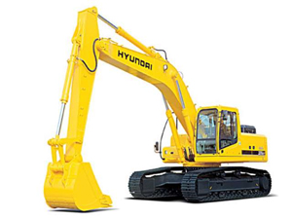
Production Planning Management
Excavator producers in Korea
Hyundai, Doosan…
Excavators are pretty expensive
Start production when orders come in
Any problem?
Orders always change
Cancelling
Changing the delivery date
Changing the specification
Changes get more difficult to handle when they are aggregated for a month-long production list
How to store and manage the production data?

Slide 11
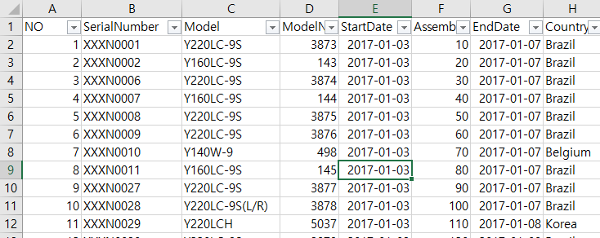
For your information: Dataset
You are given four production plans of excavator production
Plan on Dec 17, 2012
Four columns
No: just a number on the row
Serial Number: Unique identifier of an order
Model: Model name of the excavator
Model Number: The unique number of the product in the model line
Start Date: Production start date
Assembly Order: Production order
End Date: Production end date
Country: Order origination

Slide 12
Manufacturing Execution System
Line 1
Processor 1
Processor 2
Processor 3
Planned Product
In the code, we have two lines with five processors
Finished Product
Line 2
Processor 4
Processor 5
Processor 6
Now, processors can break down with a probability
Then, the processor will not process the product at the turn
Each product in the processors will make “1” cost
Then, complete the dynamic programming to select a line for the next planned product. Selecting either line 1 or line 2
Complete “selectLine” in Factory.m
Problem 1. Cost calculation with dynamic programming

Slide 13
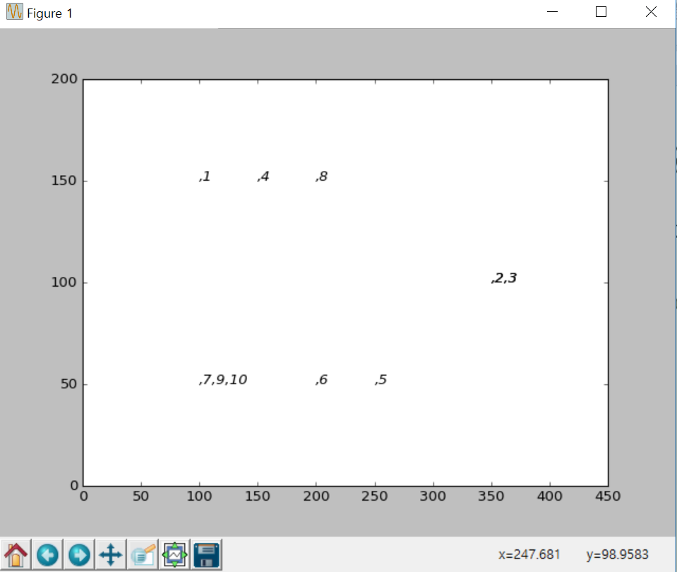
Execution Result
When you complete the codes, you are expected to see the below results.
Execute ‘main.py’
f=Factory(Filename,0.3)
Break down Probability

